Slide 1
Module-1.2
CSE3155 DATA COMMUNICATION AND COMPUTER NETWORKS
Physical Layer
1

Slide 2
Functions of Physical Layer
Physical characteristics of interfaces and medium: characteristics of Interface between devices and types of transmission media.
Representation of bits: It encodes the bit stream into electrical or optical signal.
Data rate: Transmission rate, number of bits sent each second.
Synchronization of bits: Sender and the receiver clocks must be synchronized.
Line configuration: Connection of devices to the media. Point-to-point or multipoint connection.
Physical topology: How devices are connected to make a network?
Transmission mode: It defines direction of the transmission between two devices. Ex. Simplex , half-duplex or full duplex mode).

Slide 3
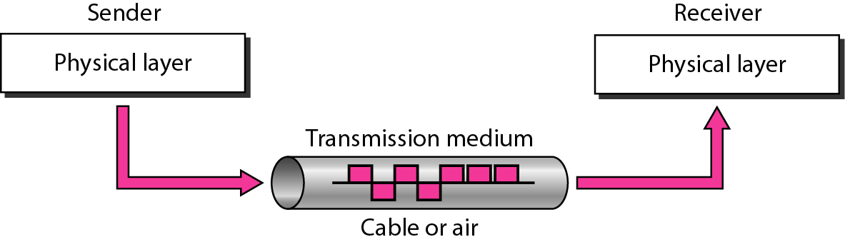
Transmission Media
Transmission Media and Physical Layer

Slide 4
Transmission Media
Transmission media are located below the physical layer.
A transmission medium can be broadly defined as anything that can carry information from a source to a destination.
Computers use signals to represent data.
Signals are transmitted in form of electromagnetic energy.

Slide 5
Factors to be considered while choosing Transmission Medium
Transmission Rate
Cost and Ease of Installation
Resistance to Environmental Conditions
Distances

Slide 6
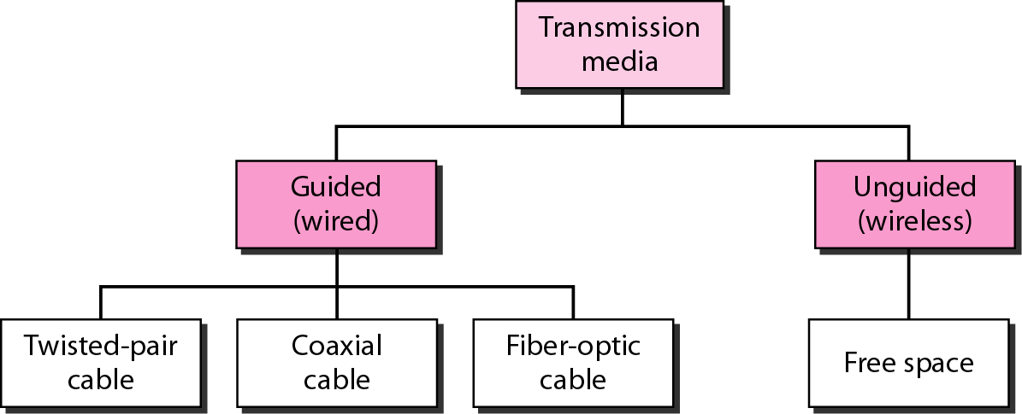
Categories of transmission media

Slide 7
GUIDED MEDIA
Guided media, which are those that provide a conduit from one device to another, include twisted-pair cable, coaxial cable, and fiber-optic cable.

Slide 8
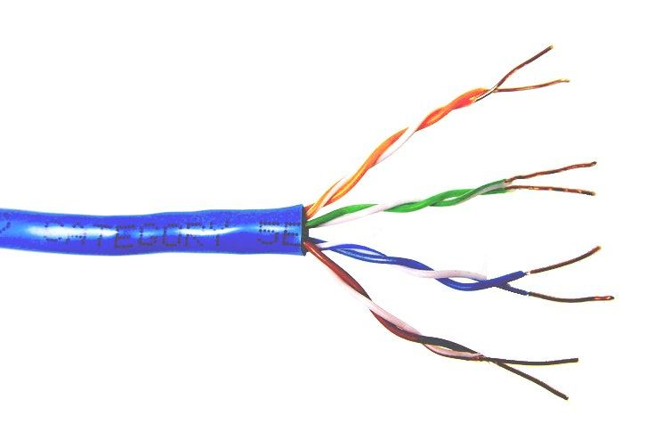
Twisted Pair Cable
This cable is the most commonly used and is cheaper than others. It is lightweight, cheap, can be installed easily, and they support many different types of network.
Twisted-pair cables are used in telephone lines to provide voice and data channels,LANs,DSLs.
Twisted Pair is of two types :
Unshielded Twisted Pair (UTP)
Shielded Twisted Pair (STP)

Slide 9
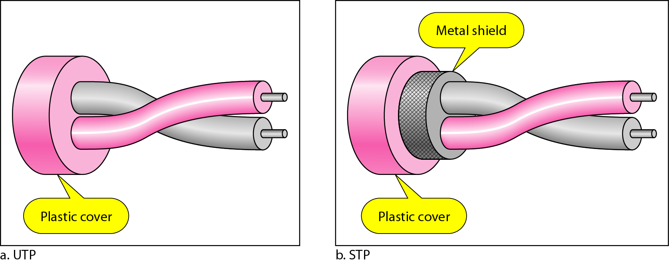
Unshielded Versus Shielded Twisted-Pair Cable
UTP and STP cables

Slide 10
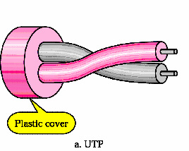
Unshielded Twisted Pair (UTP)
Adv:
Ordinary telephone wire
Cheapest
Easiest to install
It has high speed capacity
100 meter limit
Dis adv:
Bandwidth is low when compared with Coaxial Cable
Provides less protection from interference.

Slide 11
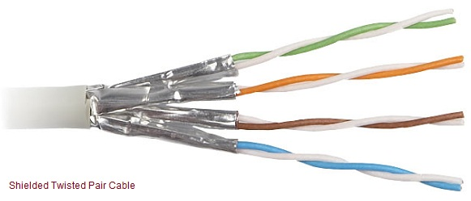

Slide 12
Shielded Twisted Pair (STP)
Adv:
Metal braid or sheathing that reduces interference
Easy to install
Eliminates crosstalk
Higher capacity than unshielded twisted pair
Increases the signaling rate
Disadv:
More expensive
Harder to handle
(thick, heavy)
Difficult to manufacture

Slide 13
Coaxial cable
Coaxial cable (or coax) carries signals of higher frequency ranges than those in twisted-pair cable, in part because the two media are constructed quite differently.
Inner conductor is a solid wire outer conductor serves both as a shield against noise and a second conductor.
Coaxial cable was widely used in analog telephone networks where a single coaxial network could carry 10,000 voice signals. Later it was used in digital telephone networks where a single coaxial cable could carry digital data up to 600 Mbps.
However, coaxial cable in telephone networks has largely been replaced today with fiber-optic cable.

Slide 14
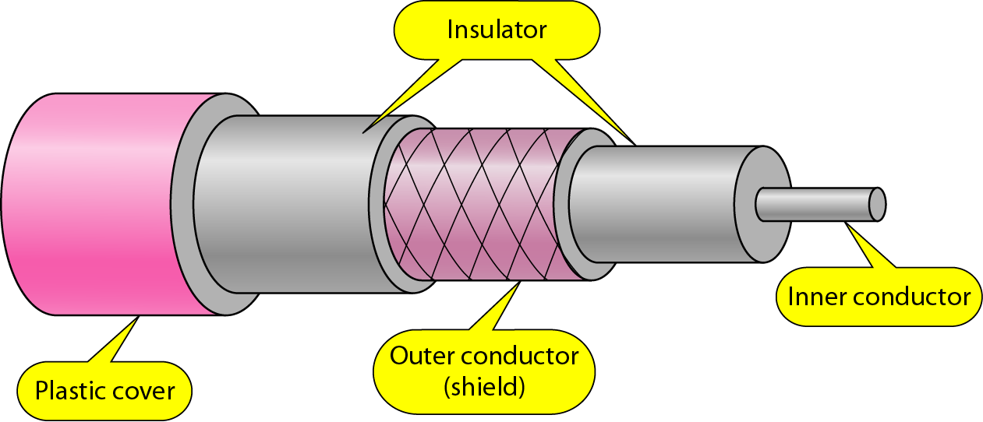
Guided Media – Coaxial Cable
Coaxial Cable

Slide 15
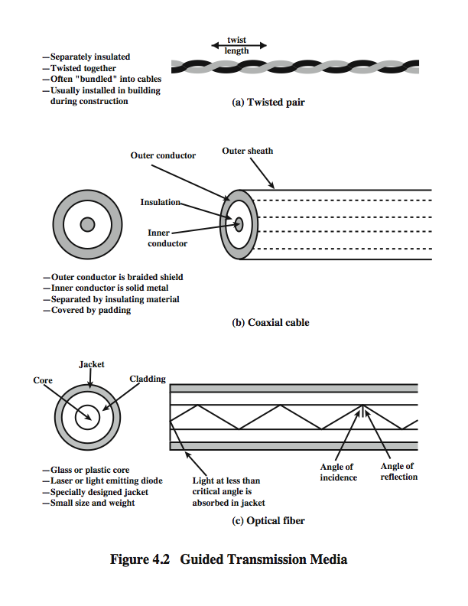
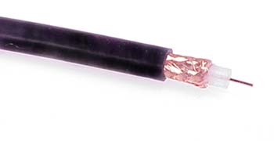
Coaxial Cable
Notes:
Coaxial cable, like twisted pair, consists of two conductors, but is constructed differently to permit it to operate over a wider range of frequencies. It consists of a hollow outer cylindrical conductor that surrounds a single inner wire conductor (Stallings DCC8e Figure 4.2b). The inner conductor is held in place by either regularly spaced insulating rings or a solid dielectric material. The outer conductor is covered with a jacket or shield. A single coaxial cable has a diameter of from 1 to 2.5 cm. Coaxial cable can be used over longer distances and support more stations on a shared line than twisted pair.
Coaxial cable is a versatile transmission medium, used in a wide variety of applications, including:
• Television distribution - aerial to TV & CATV systems
• Long-distance telephone transmission - traditionally used for inter-exchange links, now being replaced by optical fiber/microwave/satellite
• Short-run computer system links
• Local area networks

Slide 16
Guided Media – Coaxial Cable
Applications:
  Analog telephone networks
  Cable TV networks
  Traditional Ethernet LAN – 10Base2, 10Base5

Slide 17
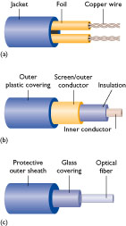
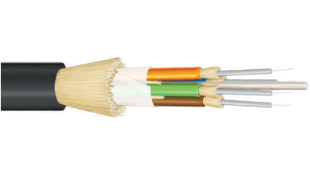
Optical Fiber Cable
Higher bandwidth
Less expensive
Immune to electrical noise
More secure – easy to notice an attempt to intercept signal
Physical characterizes
  Glass or plastic fibers
  Very thin (thinner than human hair)
  Material is light

Slide 18
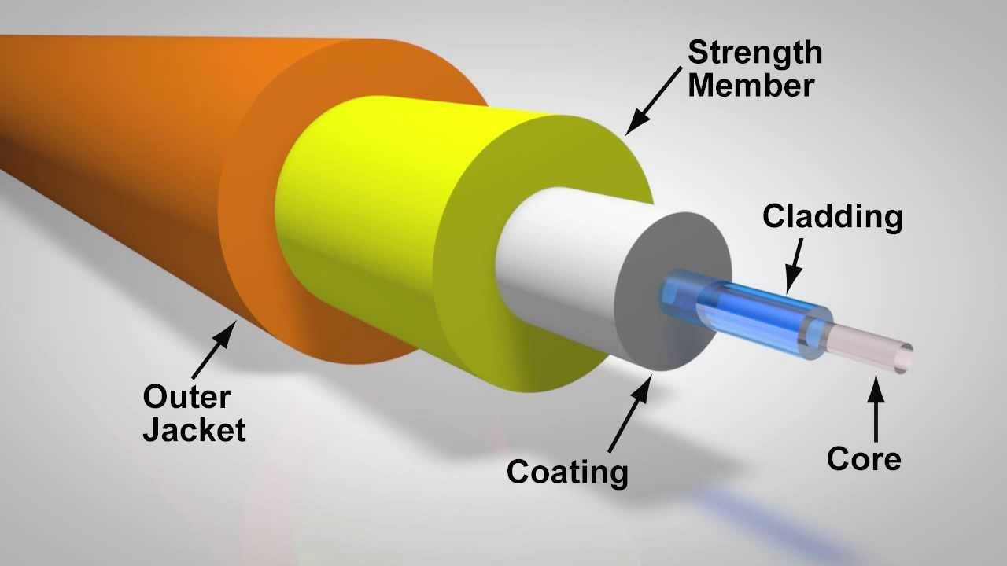
Fiber Construction

Slide 19
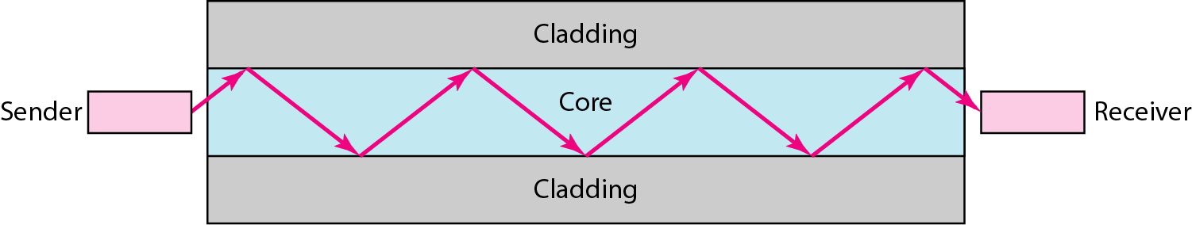
Optical fiber
Uses reflection to guide light through a channel
Core is of glass or plastic surrounded by Cladding
Cladding is of less dense glass or plastic
Jacket
An optical fiber cable has a cylindrical shape and consists of three concentric sections: the core, the cladding, and the jacket(outer part of the cable).

Slide 20
Guided Media –Optical Fiber Cable
Applications:
  Backbone networks – SONET
  Cable TV – backbone
  LAN
    100Base-FX network (Fast Ethernet)
    100Base-X

Slide 21
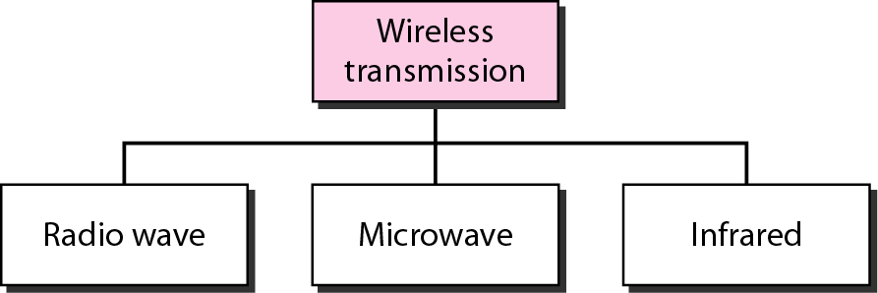
Unguided Media
Wireless transmission waves

Slide 22
Radio Waves
Radio waves, particularly those waves that propagate in the sky mode, can travel long distances.
Radio waves, for the most part, are omnidirectional. When an antenna transmits radio waves, they are propagated in all directions. This means that
the sending and receiving antennas do not have to be aligned.
Radio waves, particularly those of low and medium frequencies, can penetrate walls.
Its frequency is between 3 kHz to 1GHz.
It is simple to install and has high attenuation.
Notes:
Radio is a general term used to encompass frequencies in the range of 3 kHz to 300 GHz. We are using the informal term broadcast radio to cover the VHF and part of the UHF band: 30 MHz to 1 GHz. This range covers FM radio and UHF and VHF television. This range is also used for a number of data networking applications. The principal difference between broadcast radio and microwave is that the former is omnidirectional and the latter is directional. Thus broadcast radio does not require dish-shaped antennas, and the antennas need not be rigidly mounted to a precise alignment.
The range 30 MHz to 1 GHz is an effective one for broadcast communications. Unlike the case for lower-frequency electromagnetic waves, the ionosphere is transparent to radio waves above 30 MHz. Thus transmission is limited to the line of sight, and distant transmitters will not interfere with each other due to reflection from the atmosphere. Unlike the higher frequencies of the microwave region, broadcast radio waves are less sensitive to attenuation from rainfall. A prime source of impairment for broadcast radio waves is multipath interference. Reflection from land, water, and natural or human-made objects can create multiple paths between antennas, eg ghosting on TV pictures.

Slide 23
Microwave
Electromagnetic waves having frequencies between 1 and 300 GHz are called microwaves.
Microwaves are unidirectional.
Line-of-site
High speed/High Frequency
Cost effective
Easy to implement
Weather can cause interference

Slide 24
Infrared Waves
Frequencies between 300 GHz to 400 THz.
Can not penetrate walls.
Used for short-range communication in a closed area using line-of-sight propagation.

Slide 25
Data and Signals
One of the major functions of the physical layer is to move data in the form of electromagnetic signals across a transmission medium.
Whether you are collecting numerical statistics from another computer, sending animated pictures from a design workstation, etc.. you are working with the transmission of data across network connections.
Generally, the data usable to a person or application are not in a form that can be transmitted over a network.
  For example, a photograph must first be changed to a form that transmission media can accept.

Slide 26
Analog and Digital
Data can be analog or digital. The term analog data refers to information that is continuous; digital data refers to information that has discrete states. Analog data take on continuous values. Digital data take on discrete values.

Slide 27
Analog and Digital Data
Data can be analog or digital.
For example, an analog clock that has hour, minute, and second hands gives information in a continuous form; the movements of the hands are continuous. On the other hand, a digital clock that reports the hours and the minutes will change suddenly from 10:05 to 10:06.
Analog data, such as the sounds made by a human voice, take on continuous values. When someone speaks, an analog wave is created in the air. This can be captured by a microphone sampled and converted to a digital signal.
Digital data take on discrete values. For example, data are stored in computer memory in the form of 0s and 1s. They can be converted to a digital signal for transmission across a medium

Slide 28
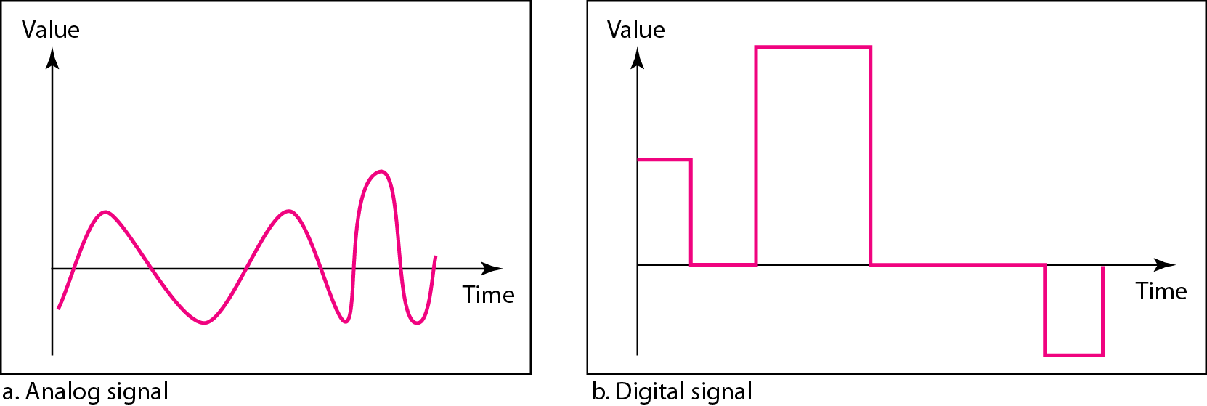
Analog and Digital Signals
Like the data they represent, signals can be either analog or digital. An analog signal has infinitely many levels of intensity over a period of time. As the wave moves from value A to value B, it passes through and includes an infinite number of values along its path. A digital signal, on the other hand, can have only a limited number of defined values. Although each value can be any number, it is often as simple as 1 and 0.
Figure : Comparison of analog and digital signals

Slide 29
Analog Signals
Periodic analog signals can be classified as simple or composite. A simple periodic analog signal, a sine wave, cannot be decomposed into simpler signals. A composite
periodic analog signal is composed of multiple sine waves.
Sine Wave
Wavelength
Time and Frequency Domain
Composite Signals
Bandwidth

Slide 30
Digital Signals
In addition to being represented by an analog signal, information can also be represented by a digital signal. For example, a 1 can be encoded as a positive voltage and a 0 as zero voltage. A digital signal can have more than two levels. In this case, we can send more than 1 bit for each level.
Bit Rate
Bit Length

Slide 31
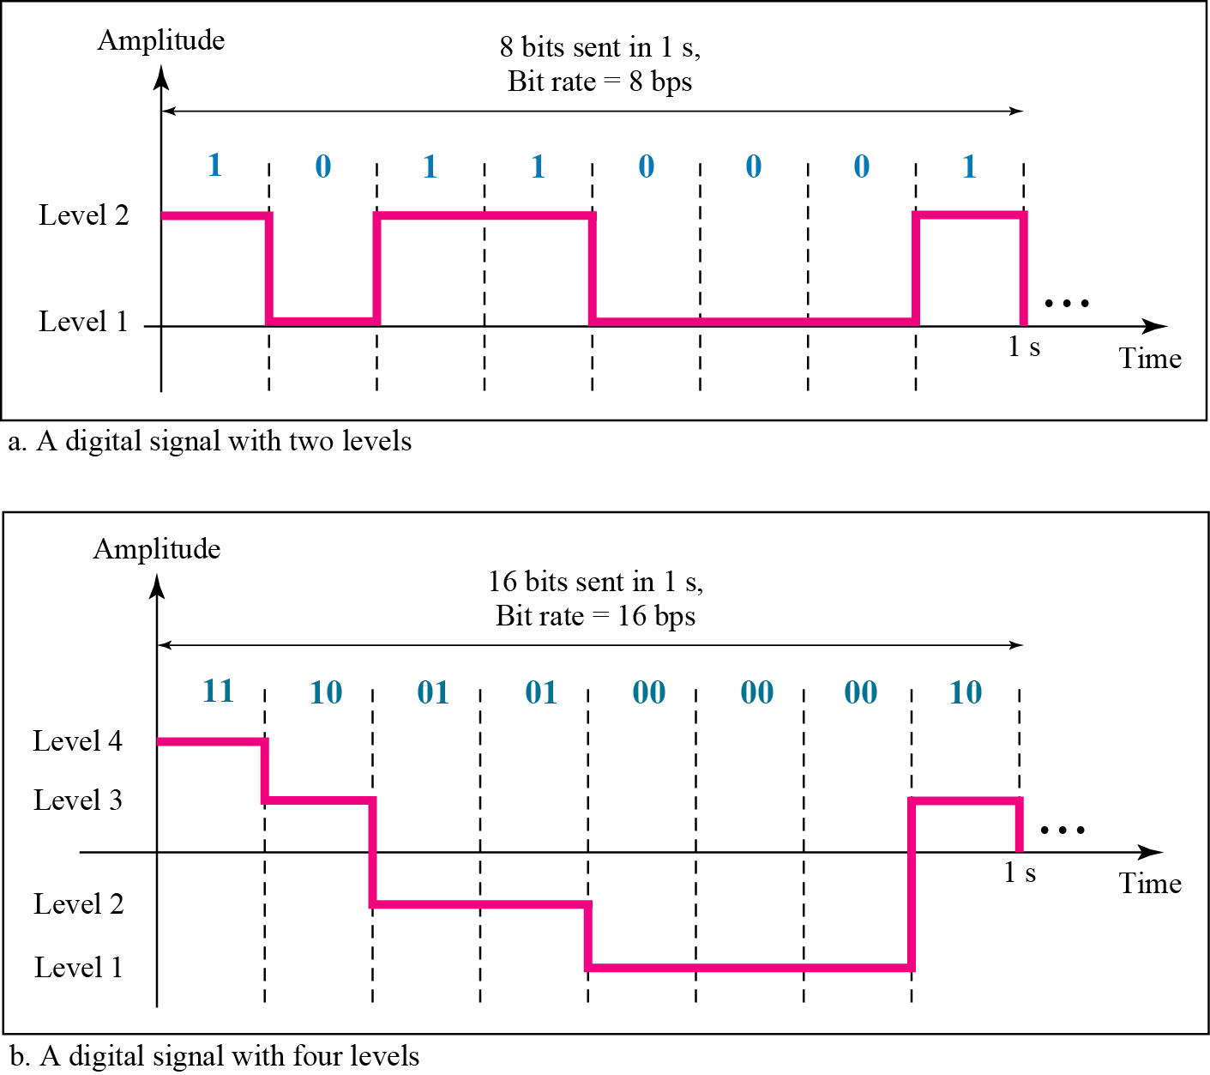
Two digital signals: one with two signal levels and the other with four signal levels

Slide 32
Example
A digital signal has eight levels. How many bits are needed per level? We calculate the number of bits from the formula
Each signal level is represented by 3 bits.

Slide 33
Signals travel through transmission media, which are not perfect.
The imperfection causes signal impairment.
This means that the signal at the beginning of the medium is not the same as the signal at the end of the medium. What is sent is not what is received.
Three causes of impairment are attenuation, distortion, and noise.
TRANSMISSION IMPAIRMENT

Slide 34
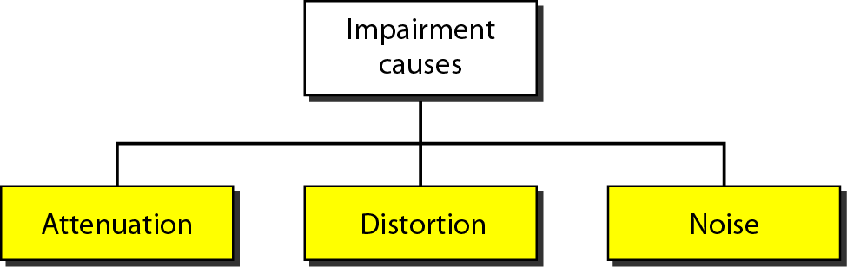
Causes of impairment

Slide 35
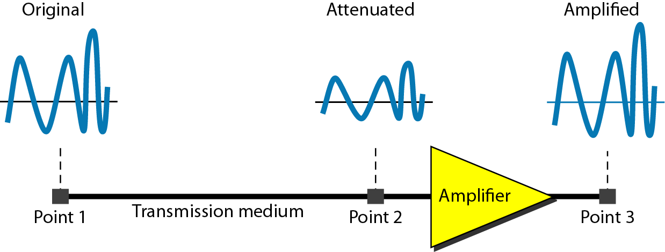
Attenuation
Attenuation means a loss of energy. When a signal travels through a medium, it loses some of its energy in overcoming the resistance of the medium.
That is why a wire carrying electric signals gets warm, if not hot, after a while.
Some of the electrical energy in the signal is converted to heat. To compensate for this loss, amplifiers are used to amplify the signal.
Figure below shows the effect of attenuation and amplification.
Figure : Attenuation

Slide 36
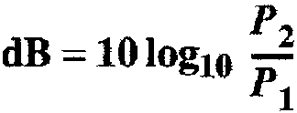
Decibel
To show that a signal has lost or gained strength, engineers use the unit of the decibel. The decibel (dB) measures the relative strengths of one signal at two different points. Note that the decibel is negative if a signal is attenuated and positive if a signal is amplified.
Variables P1 and P2 are the powers of a signal at points 1 and 2, respectively.

Slide 37

Example
Suppose a signal travels through a transmission medium and its power is reduced to one-half. This means that P2 is (1/2)P1. In this case, the attenuation (loss of power) can be calculated as
A loss of 3 dB (–3 dB) is equivalent to losing one-half the power.

Slide 38

Example
A signal travels through an amplifier, and its power is increased 10 times. This means that P₂ = 10P₁ . In this case, the amplification (gain of power) can be calculated as

Slide 39
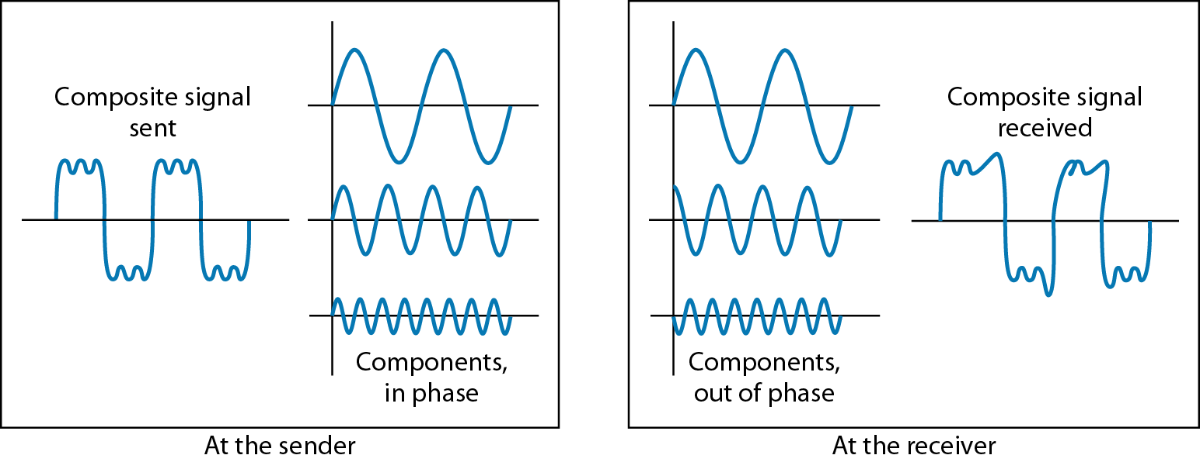
Distortion
Distortion means that the signal changes its form or shape.
Distortion can occur in a composite signal made of different frequencies.
Each signal component has its own propagation speed through a medium and, therefore, its own delay in arriving at the final destination.
Differences in delay may create a difference in phase.
In other words, signal components at the receiver have phases different from what they had at the sender. The shape of the composite signal is therefore not the same.
Figure : Distortion

Slide 40
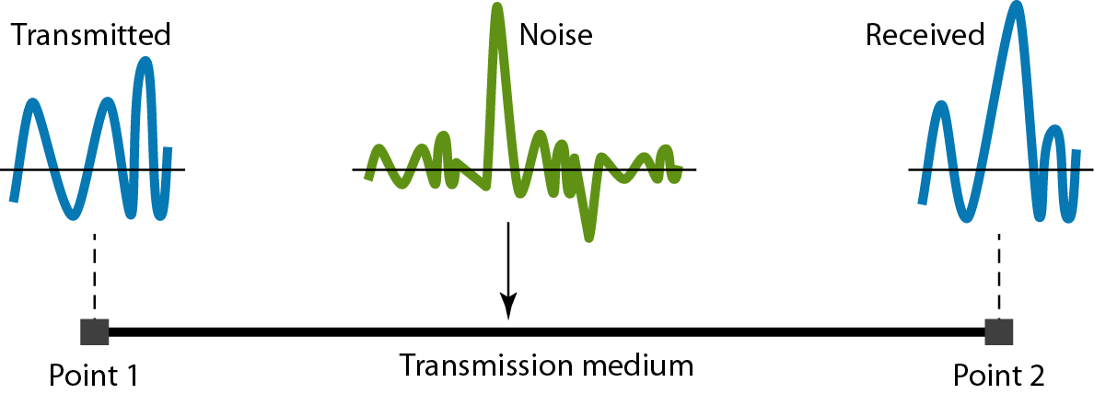
Noise
Noise is another cause of impairment. Several types of noise, such as thermal noise, induced noise, crosstalk, and impulse noise, may corrupt the signal.
Thermal noise is the random motion of electrons in a wire which creates an extra signal not originally sent by the transmitter.
Induced noise comes from sources such as motors and appliances.
Crosstalk is the effect of one wire on the other. One wire acts as a sending antenna and the other as the receiving antenna.
Impulse noise is a spike (a signal with high energy in a very short time) that comes from power lines, lightning, and so on.
Figure: Noise

Slide 41
Signal-to-Noise Ratio (SNR)
To find the theoretical bit rate limit, we need to know the ratio of the signal power to the noise power. The signal-to-noise ratio is defined as:
SNR = average signal power
average noise power
SNR is actually the ratio of what is wanted (signal) to what is not wanted (noise). A high SNR means the signal is less corrupted by noise; a low SNR means the signal is more corrupted by noise.
Because SNR is the ratio of two powers, it is often described in decibel units, SNR_{dB}, defined as
SNR_{dB}⁼ 10log₁₀ SNR

Slide 42
Example
The power of a signal is 10 mW and the power of the noise is 1 μW; what are the values of SNR and SNR_{dB} ?
Solution
The values of SNR and SNRdB can be calculated as follows:

Slide 43
Example
The values of SNR and SNRdB for a noiseless channel are
We can never achieve this ratio in real life; it is an ideal.

Slide 44
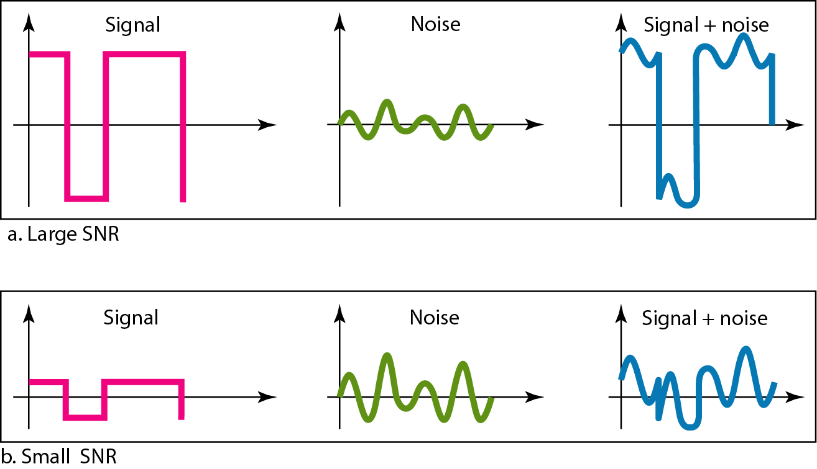
Figure Two cases of SNR: a high SNR and a low SNR

Slide 45
DATA RATE LIMITS
A very important consideration in data communications is how fast we can send data, in bits per second, over a channel. Data rate depends on three factors:
1. The bandwidth available
2. The level of the signals we use
3. The quality of the channel (the level of noise)
Two Categories:
Noiseless Channel: Nyquist Bit Rate
Noisy Channel: Shannon Capacity

Slide 46
Nyquist Theorem
Nyquist gives the upper bound for the bit rate of a transmission system by calculating the bit rate directly from the number of bits in a symbol (or signal levels) and the bandwidth of the system (assuming 2 symbols/per cycle and first harmonic).
Nyquist theorem states that for a noiseless channel:
C = 2 B log₂L
C= capacity in bps
B = bandwidth in Hz
L=Levels in signal

Slide 47
Example
Consider a noiseless channel with a bandwidth of 3000 Hz transmitting a signal with two signal levels. The maximum bit rate can be calculated as:

Slide 48
Example
We need to send 265 kbps over a noiseless channel with a bandwidth of 20 kHz. How many signal levels do we need?
Solution
We can use the Nyquist formula as shown:
Since this result is not a power of 2, we need to either increase the number of levels or reduce the bit rate. If we have 128 levels, the bit rate is 280 kbps. If we have 64 levels, the bit rate is 240 kbps.

Slide 49
Noisy Channel and Shannon Capacity
Consider an extremely noisy channel in which the value of the signal-to-noise ratio is almost zero.
For noisy channel the capacity C (highest data rate) is calculated as:
This means that the capacity of this channel is zero regardless of the bandwidth. In other words, we cannot receive any data through this channel.

Slide 50
Example
We have a channel with a 1-MHz bandwidth. The SNR for this channel is 63. What are the appropriate bit rate and signal level?
Solution
First, we use the Shannon formula to find the upper limit.

Slide 51

Note
The Shannon capacity gives us the upper limit; the Nyquist formula tells us how many signal levels we need.

Slide 52
PERFORMANCE
One important issue in networking is the performance of the network—how good is it? We discuss quality of service, an overall measurement of network performance,
Topics discussed in this section:
Bandwidth
Throughput
Latency (Delay)
Bandwidth-Delay Product
Jitter

Slide 53
Bandwidth
One characteristic that measures network performance is bandwidth. However, the term can be used in two different contexts with two different measuring values:
          bandwidth in hertz
          bandwidth in bits per second.

Slide 54
Bandwidth in Hertz & in bits per second
Bandwidth in hertz is the range of frequencies contained in a composite signal or the range of frequencies a channel can pass. For example, we can say the bandwidth of a subscriber telephone line is 4 kHz.
The term bandwidth can also refer to the number of bits per second that a channel, a link, or even a network can transmit. For example, one can say the bandwidth of a Fast Ethernet network (or the links in this network) is a maximum of 100 Mbps. This means that this network can send 100 Mbps.

Slide 55
Throughput
The throughput is a measure of how fast we can actually send data through a network.
Although, at first glance, bandwidth in bits per second and throughput seem the same, they are different. A link may have a bandwidth of B bps, but we can only send T bps through this link with ‘T’ always less than ‘B’.
In other words, the bandwidth is a potential measurement of a link; the throughput is an actual measurement of how fast we can send data.
For example, we may have a link with a bandwidth of 1 Mbps, but the devices connected to the end of the link may handle only 200 kbps. This means that we cannot send more than 200 kbps through this link.
Imagine a highway designed to transmit 1000 cars per minute from one point to another. However, if there is congestion on the road, this figure may be reduced to 100 cars per minute. The bandwidth is 1000 cars per minute; the throughput is 100 cars per minute.

Slide 56
Latency (Delay)
The latency or delay defines how long it takes for an entire message to completely arrive at the destination from the time the first bit is sent out from the source.
We can say that latency is made of four components: propagation time, transmission time, queuing time and processing delay.
Latency = propagation time +transmission time +queuing time + processing delay

Slide 57
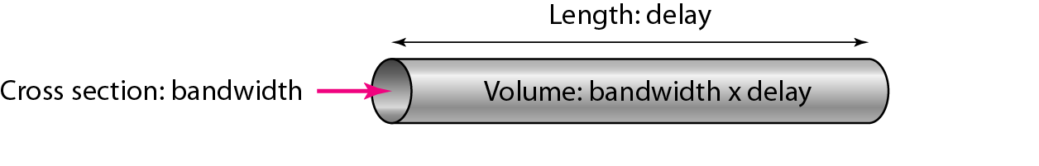
Bandwidth-Delay Product
Bandwidth and delay are two performance metrics of a link. what is very important in data communications is the product of the two, the bandwidth-delay product.
Figure : Concept of bandwidth-delay product
Note
The bandwidth-delay product defines the number of bits that can fill the link.

Slide 58
Jitter
Jitter is variation in packet arrival time.
Jitter is a problem if different packets of data encounter different delays and the application using the data at the receiver site is time-sensitive (audio and video data, for example).
If the delay for the first packet is 20 ms, for the second is 45 ms, and for the third is 40 ms, then the real-time application that uses the packets endures jitter.

Slide 59
MULTIPLEXING
Whenever the bandwidth of a medium linking two devices is greater than the bandwidth needs of the devices, the link can be shared. Multiplexing is the set of techniques that allows the simultaneous transmission of multiple signals across a single data link. As data and telecommunications use increases, so does traffic.

Slide 60
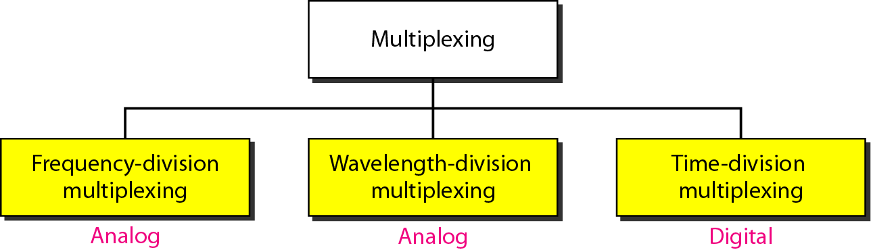
Categories of multiplexing

Slide 61
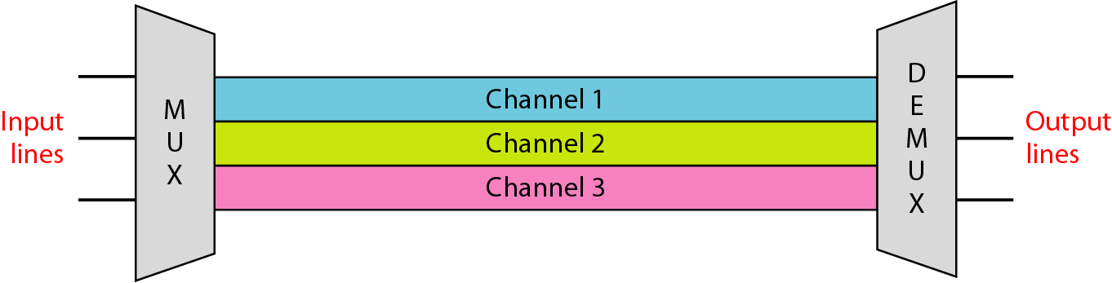
Frequency-division multiplexing
FDM is an analog multiplexing technique that combines analog signals.

Slide 62
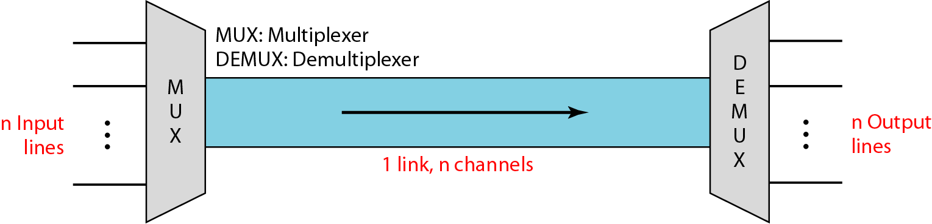
Dividing a link into channels

Slide 63
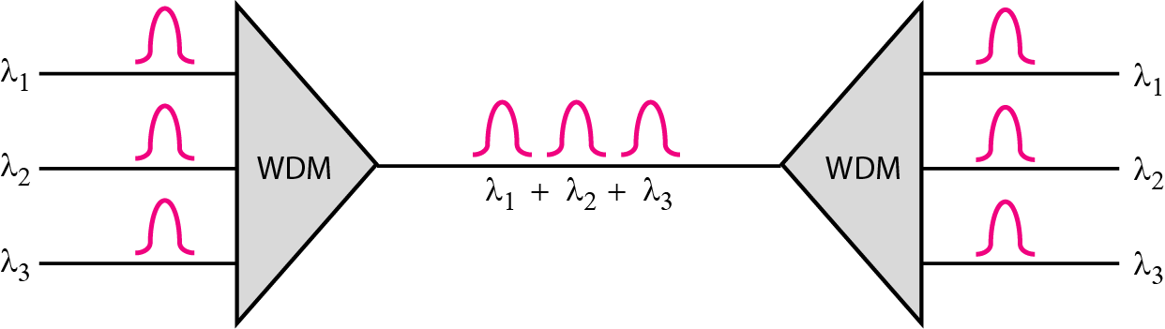
Wavelength-division multiplexing
WDM is an analog multiplexing technique to combine optical signals.

Slide 64
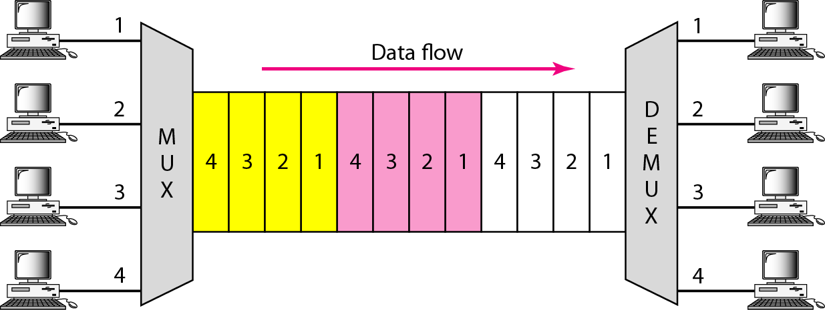
Time-division multiplexing
TDM is a digital multiplexing technique for combining several low-rate
channels into one high-rate one.

Slide 65
SPREAD SPECTRUM
In spread spectrum (SS), we combine signals from different sources to fit into a larger bandwidth, but our goals are to prevent eavesdropping and jamming. To achieve these goals, spread spectrum techniques add redundancy.
Categories
Frequency Hopping Spread Spectrum (FHSS)
Direct Sequence Spread Spectrum Synchronous (DSSS)

Slide 66
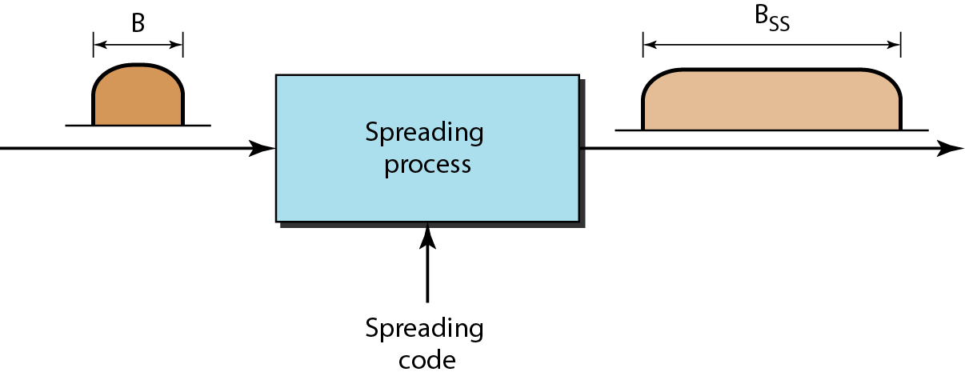
Spread spectrum

Slide 67
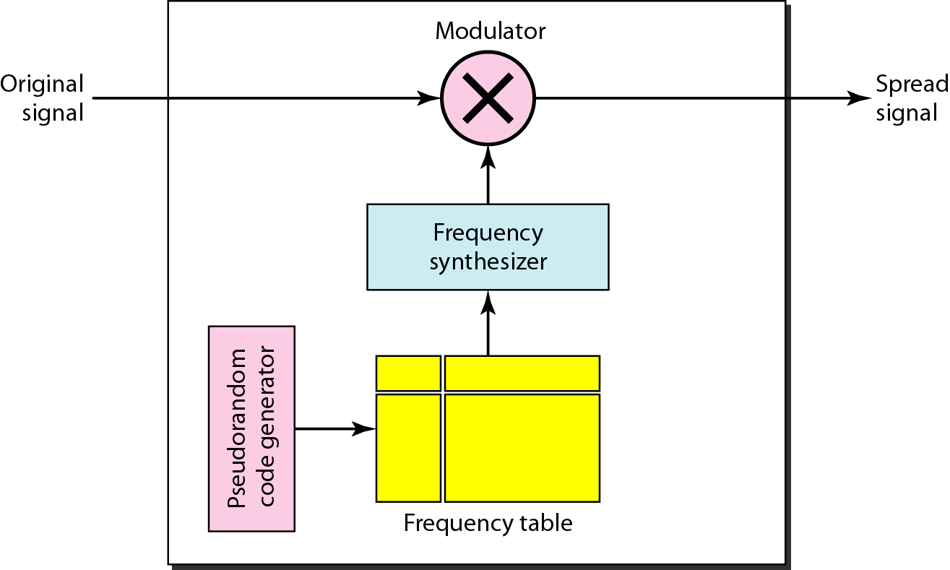
Frequency hopping spread spectrum (FHSS)

Slide 68
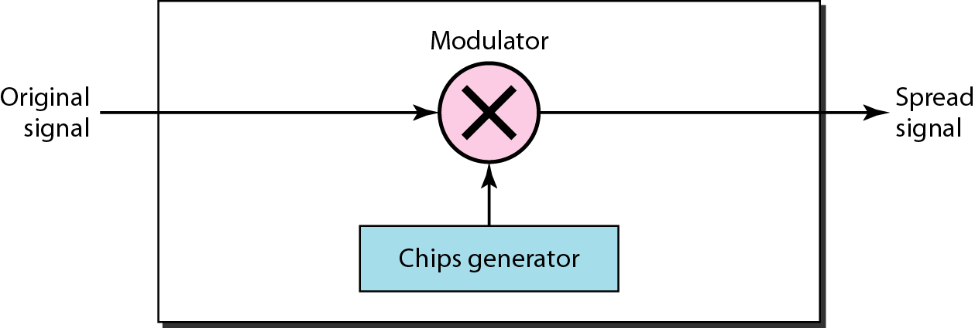
Direct Sequence Spread Spectrum Synchronous (DSSS)

Slide 69
END OF MODULE 1.2

